Slide 1
Curriculum Adoption
MS/HS Math Department
2023
Heather

Slide 2
Proposal
The Mathematics Department proposes to adopt the Illustrative Mathematics Curriculum (Kendall Hunt) for Grades 6-9. We will supplement this curriculum with other tools like Desmos, Kuta Software, and GeoGebra.
Heather

Slide 3
Topics to Review
◊How we narrowed it down
◊ Typical Lesson for Illustrative Math
◊ Access for Multilingual Learners
◊ Access for Students with Disabilities
◊ Recent updates in 2019
◊ Assessments, Checking for Understanding
◊ Summative Assessments
◊ Problem Based Curriculum
◊ Bias Review
◊ Cost
Heather

Slide 4
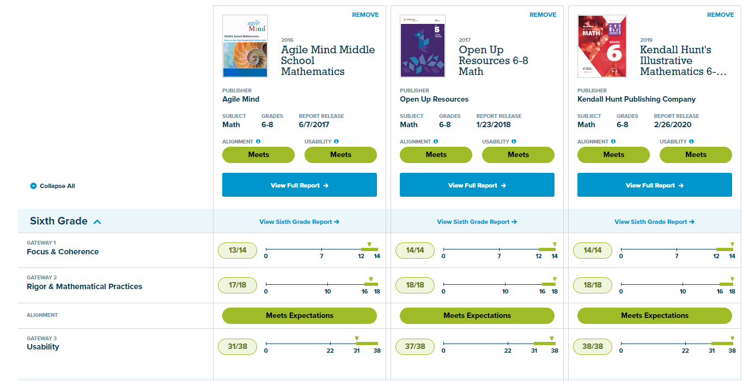
How we narrowed it down
Lesson Narrative (Each course contains 9 lessons. Each unit is between 11-23 lessons)
Learning Goals
Student-worded objective(s)
Required materials
Required Preparation
Common core standards (with links to the standard)
Glossary terms
Links to print materials:
Student tasks
Problem Sets
Cool Downs (Exit Tickets)
Teacher Guide
Teacher Presentation Materials
Outline of the lesson topics in each unit
Lesson plans (for 45 minute class)
Warm-up
Activity
Practice
Cool Down
Each unit has a diagnostic assessment and a post-assessment. Some have mid-unit assessments
Students can work on workbooks, pdfs, or online
Between: Agile Mind, Open Up Resources 6-8, Kendall Hunt Illustrative Math. Filtered by:
Usability
Alignment to CCSS
Technology
Kamie

Slide 5
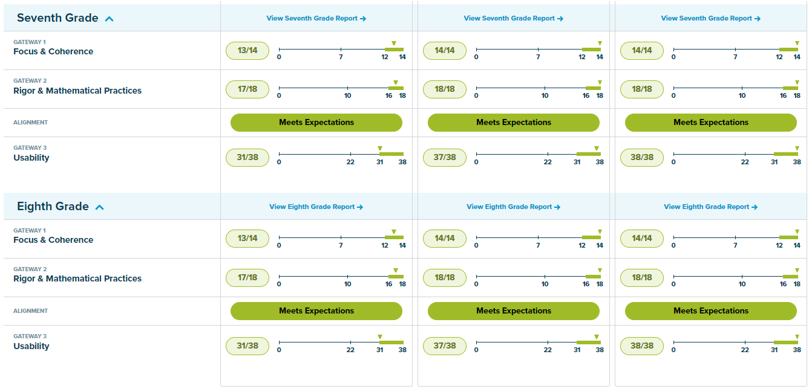
How we narrowed it down
Lesson Narrative (Each course contains 9 lessons. Each unit is between 11-23 lessons)
Learning Goals
Student-worded objective(s)
Required materials
Required Preparation
Common core standards (with links to the standard)
Glossary terms
Links to print materials:
Student tasks
Problem Sets
Cool Downs (Exit Tickets)
Teacher Guide
Teacher Presentation Materials
Outline of the lesson topics in each unit
Lesson plans (for 45 minute class)
Warm-up
Activity
Practice
Cool Down
Each unit has a diagnostic assessment and a post-assessment. Some have mid-unit assessments
Students can work on workbooks, pdfs, or online
Kamie

Slide 6
What Illustrative Math (IM) Provides
Lesson Narrative (Each course contains 9 lessons. Each unit is between 11-23 lessons)
Learning Goals
Student-worded objective(s)
Required materials
Required Preparation
Common core standards (with links to the standard)
Glossary terms
Links to print materials:
Student tasks
Problem Sets
Cool Downs (Exit Tickets)
Teacher Guide
Teacher Presentation Materials
Outline of the lesson topics in each unit
Lesson plans (for 45 minute class)
Warm-up
Activity
Practice
Cool Down
Each unit has a diagnostic assessment and a post-assessment. Some have mid-unit assessments
Students can work on workbooks, pdfs, or online
Lesson Narrative (Each course contains 9 lessons. Each unit is between 11-23 lessons)
Learning Goals
Student-worded objective(s)
Required materials
Required preparation
Common core standards (with links to the standard)
Glossary Terms
8) Links to print materials:
Student tasks
Problem Sets
Cam

Slide 7
What IM Provides
Lesson Narrative (Each course contains 9 lessons. Each unit is between 11-23 lessons)
Learning Goals
Student-worded objective(s)
Required materials
Required Preparation
Common core standards (with links to the standard)
Glossary terms
Links to print materials:
Student tasks
Problem Sets
Cool Downs (Exit Tickets)
Teacher Guide
Teacher Presentation Materials
Outline of the lesson topics in each unit
Lesson plans (for 45 minute class)
Warm-up
Activity
Practice
Cool Down
Each unit has a diagnostic assessment and a post-assessment. Some have mid-unit assessments
Students can work on workbooks, pdfs, or online
c. Cool Downs (Exit Tickets)
d. Teacher Guide
e. Teacher Presentation Materials
9) Outline of the lesson topics in each unit
10) Lesson plans (for 45 minute class)
Warm-up
Activity
Practice
Cool Down
11) Each unit has a diagnostic assessment and a post-assessment. Some have mid-unit assessments
12) Students can work on workbooks, pdfs, or online
Cam

Slide 8
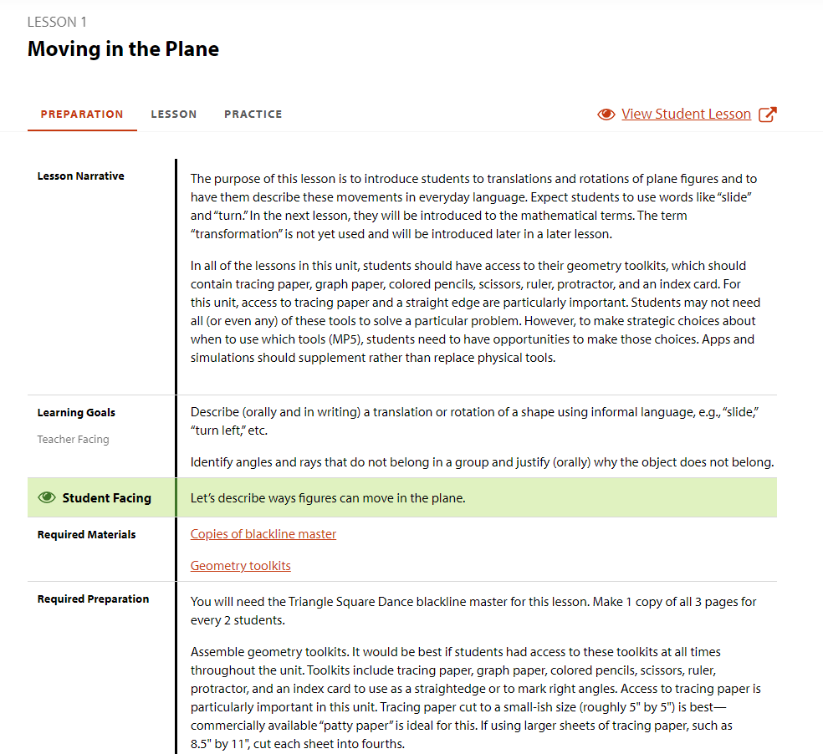
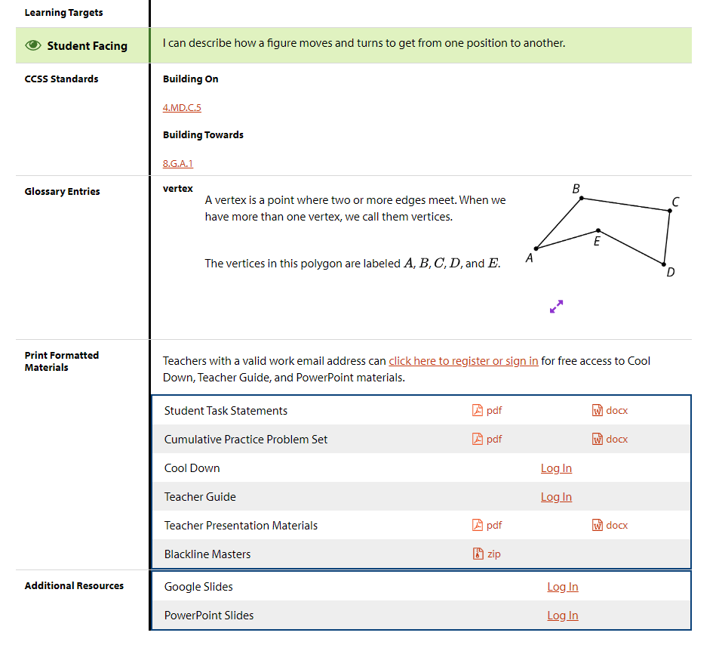
Example Lesson and Practice
What IM Provides
Cam

Slide 9
Typical Lesson
Lesson Narrative (Each course contains 9 lessons. Each unit is between 11-23 lessons)
Learning Goals
Student-worded objective(s)
Required materials
Required Preparation
Common core standards (with links to the standard)
Glossary terms
Links to print materials:
Student tasks
Problem Sets
Cool Downs (Exit Tickets)
Teacher Guide
Teacher Presentation Materials
Outline of the lesson topics in each unit
Lesson plans (for 45 minute class)
Warm-up
Activity
Practice
Cool Down
Each unit has a diagnostic assessment and a post-assessment. Some have mid-unit assessments
Students can work on workbooks, pdfs, or online
A warm-up, one or more instructional activities, a lesson synthesis, a cool down (exit ticket)
Warmup: Helps students prepare and get ready for the lesson
Instructional Activities: provides new language, real-world applications, examples, multiple representations, identifies common mistakes, practice of math language and concepts, and opportunity to model or apply knowledge
Synthesis: 5-10 minutes to synthesize what they’ve learned, big picture understanding, verbal prompts where students add answers to notebooks/graphic organizers/word walls
Cool Down: 5-minute exit ticket-students complete a task and this is used as a formative assessment. Teachers can inform their instruction based on feedback.
Cam

Slide 10
Access for Multilingual Learners (ML)
Lesson Narrative (Each course contains 9 lessons. Each unit is between 11-23 lessons)
Learning Goals
Student-worded objective(s)
Required materials
Required Preparation
Common core standards (with links to the standard)
Glossary terms
Links to print materials:
Student tasks
Problem Sets
Cool Downs (Exit Tickets)
Teacher Guide
Teacher Presentation Materials
Outline of the lesson topics in each unit
Lesson plans (for 45 minute class)
Warm-up
Activity
Practice
Cool Down
Each unit has a diagnostic assessment and a post-assessment. Some have mid-unit assessments
Students can work on workbooks, pdfs, or online
With the lessons, there is guidance to help teachers recognize and support students’ academic language acquisition
Students will get practice with reading, writing, speaking, listening, and conversing mathematically
Language goals embedded in learning goals
Scaffolded lessons and an emphasis on language
Spanish translations for each unit for grades 6-9
Lauren

Slide 11
Access for Students with Disabilities
Lesson Narrative (Each course contains 9 lessons. Each unit is between 11-23 lessons)
Learning Goals
Student-worded objective(s)
Required materials
Required Preparation
Common core standards (with links to the standard)
Glossary terms
Links to print materials:
Student tasks
Problem Sets
Cool Downs (Exit Tickets)
Teacher Guide
Teacher Presentation Materials
Outline of the lesson topics in each unit
Lesson plans (for 45 minute class)
Warm-up
Activity
Practice
Cool Down
Each unit has a diagnostic assessment and a post-assessment. Some have mid-unit assessments
Students can work on workbooks, pdfs, or online
Lesson structures are consistent
Individual, pair, small group, and whole class discussions
Real-World contexts
Assisted technology for visualizing
Manipulatives for understanding
Visual aids for conceptualizing
Graphic Organizers
Brain breaks
Supplemental instructional strategies for students with disabilities are included in each lesson
Topics are taught and represented in multiple ways
Lauren

Slide 12
Recent Updates in 2019
Lesson Narrative (Each course contains 9 lessons. Each unit is between 11-23 lessons)
Learning Goals
Student-worded objective(s)
Required materials
Required Preparation
Common core standards (with links to the standard)
Glossary terms
Links to print materials:
Student tasks
Problem Sets
Cool Downs (Exit Tickets)
Teacher Guide
Teacher Presentation Materials
Outline of the lesson topics in each unit
Lesson plans (for 45 minute class)
Warm-up
Activity
Practice
Cool Down
Each unit has a diagnostic assessment and a post-assessment. Some have mid-unit assessments
Students can work on workbooks, pdfs, or online
More supports for MLs
Lessons in Spanish (online) for grades 6-9
These translations were done by math teachers who were fluent in both English and Spanish
Student Glossary improvements
Supports for learning disabilities with learning levels
Alt text for visually impaired
Lauren

Slide 13
Assessments, Checking for Understanding
Lesson Narrative (Each course contains 9 lessons. Each unit is between 11-23 lessons)
Learning Goals
Student-worded objective(s)
Required materials
Required Preparation
Common core standards (with links to the standard)
Glossary terms
Links to print materials:
Student tasks
Problem Sets
Cool Downs (Exit Tickets)
Teacher Guide
Teacher Presentation Materials
Outline of the lesson topics in each unit
Lesson plans (for 45 minute class)
Warm-up
Activity
Practice
Cool Down
Each unit has a diagnostic assessment and a post-assessment. Some have mid-unit assessments
Students can work on workbooks, pdfs, or online
There are multiple opportunities for formative and summative assessments in the unit
Diagnostic Test to start the unit
These assess pre-knowledge
These also assess pre-requisite knowledge
Cool Down Tasks (Exit Tickets) provided for each lesson
Practice Problems (for in class practice or homework)
Brittany

Slide 14
Summative Assessments
Lesson Narrative (Each course contains 9 lessons. Each unit is between 11-23 lessons)
Learning Goals
Student-worded objective(s)
Required materials
Required Preparation
Common core standards (with links to the standard)
Glossary terms
Links to print materials:
Student tasks
Problem Sets
Cool Downs (Exit Tickets)
Teacher Guide
Teacher Presentation Materials
Outline of the lesson topics in each unit
Lesson plans (for 45 minute class)
Warm-up
Activity
Practice
Cool Down
Each unit has a diagnostic assessment and a post-assessment. Some have mid-unit assessments
Students can work on workbooks, pdfs, or online
Types of problems: multiple choice, multiple response, short answer, restricted constructed response, and extended response.
Problems vary in difficulty
Teachers can make changes to assessments
Teachers have flexibility on how to grade assessments (partial credit, allow for student explanations/work to be graded)
Rubrics for long responses provided
Performance Tasks: Students have the ability to show their problem-solving skills with applied real-world problems
Brittany

Slide 15
Problem-Based Curriculum
Lesson Narrative (Each course contains 9 lessons. Each unit is between 11-23 lessons)
Learning Goals
Student-worded objective(s)
Required materials
Required Preparation
Common core standards (with links to the standard)
Glossary terms
Links to print materials:
Student tasks
Problem Sets
Cool Downs (Exit Tickets)
Teacher Guide
Teacher Presentation Materials
Outline of the lesson topics in each unit
Lesson plans (for 45 minute class)
Warm-up
Activity
Practice
Cool Down
Each unit has a diagnostic assessment and a post-assessment. Some have mid-unit assessments
Students can work on workbooks, pdfs, or online
Curriculum works to cultivate the growth-mindset mentality. Work ethic, not pure innate skill, brings about math understanding. Anyone can do math.
Focus on the following forms of knowledge:
Conceptual Understanding
Procedural Fluency
Application
Students should not just learn about mathematics; they should DO math.
Focus on problem solving, not lecturing
Students take an active role in their own learning
Brittany

Slide 16
Bias Review
Lesson Narrative (Each course contains 9 lessons. Each unit is between 11-23 lessons)
Learning Goals
Student-worded objective(s)
Required materials
Required Preparation
Common core standards (with links to the standard)
Glossary terms
Links to print materials:
Student tasks
Problem Sets
Cool Downs (Exit Tickets)
Teacher Guide
Teacher Presentation Materials
Outline of the lesson topics in each unit
Lesson plans (for 45 minute class)
Warm-up
Activity
Practice
Cool Down
Each unit has a diagnostic assessment and a post-assessment. Some have mid-unit assessments
Students can work on workbooks, pdfs, or online
https://www.k12.wa.us/sites/default/files/public/equity/pubdocs/washingtonmodelsfortheevaluationofbias.pdf
Using the Washington Models for the Evaluation Bias Content in Instructional Materials and following the criteria outlined in school board policy 2020, the following is a summary of our bias review:
Kate

Slide 17
Bias Review
Lesson Narrative (Each course contains 9 lessons. Each unit is between 11-23 lessons)
Learning Goals
Student-worded objective(s)
Required materials
Required Preparation
Common core standards (with links to the standard)
Glossary terms
Links to print materials:
Student tasks
Problem Sets
Cool Downs (Exit Tickets)
Teacher Guide
Teacher Presentation Materials
Outline of the lesson topics in each unit
Lesson plans (for 45 minute class)
Warm-up
Activity
Practice
Cool Down
Each unit has a diagnostic assessment and a post-assessment. Some have mid-unit assessments
Students can work on workbooks, pdfs, or online
We went through roughly 2,400 pages of Illustrative Curriculum to look at bias in gender/sex, culture, disabilities, socio-economic status, and family. Through this research, we found that there was little to no bias. Due to the nature of a math textbook, the majority of the curriculum was focused on content. The text is full of math diagrams: tables, polygons, equations, graphs, number lines, and scatterplots. Of the photos in the book, most of them were of real-world objects like: beans in a jar, tile designs, maps, and food items in the shape of common geometric solids.
Kate

Slide 18
Bias Review
Lesson Narrative (Each course contains 9 lessons. Each unit is between 11-23 lessons)
Learning Goals
Student-worded objective(s)
Required materials
Required Preparation
Common core standards (with links to the standard)
Glossary terms
Links to print materials:
Student tasks
Problem Sets
Cool Downs (Exit Tickets)
Teacher Guide
Teacher Presentation Materials
Outline of the lesson topics in each unit
Lesson plans (for 45 minute class)
Warm-up
Activity
Practice
Cool Down
Each unit has a diagnostic assessment and a post-assessment. Some have mid-unit assessments
Students can work on workbooks, pdfs, or online
In 2,400 pages, we found only two pictures of humans. In one photo, the white individuals were standing in front of a building with shadows (for the similar triangles unit). They were dressed in casual clothes and were of three different ages. In addition, there was a photo of a person at a public transportation ticket booth. This person had their back to the camera. It was unclear whether they were female or male. Their ethnicity was unclear. Besides these photographs, there were no illustrations of humans.
All other illustrations were of mathematical terms or common objects (like popcorn, moon phases, ladybugs, etc.). Once every 50-100 pages, there is a word problem using a person’s name. The names used repeated throughout the course: Jada, Lin, Diego, Andre, Elena, Priya, Clare, Kiran, Noah, Mai, and Tyler. These names represent a variety of genders and ethnicities.
Kate

Slide 19
Bias Review
Lesson Narrative (Each course contains 9 lessons. Each unit is between 11-23 lessons)
Learning Goals
Student-worded objective(s)
Required materials
Required Preparation
Common core standards (with links to the standard)
Glossary terms
Links to print materials:
Student tasks
Problem Sets
Cool Downs (Exit Tickets)
Teacher Guide
Teacher Presentation Materials
Outline of the lesson topics in each unit
Lesson plans (for 45 minute class)
Warm-up
Activity
Practice
Cool Down
Each unit has a diagnostic assessment and a post-assessment. Some have mid-unit assessments
Students can work on workbooks, pdfs, or online
Students are occasionally asked to evaluate whose mathematical reasoning is better. For example, the students may be asked to evaluate Clare’s diagram verses Diego’s diagram. Because these names are often repeated, sometimes the male student is correct, and sometimes the female student is correct. Moreover, sometimes the minority student is correct, and sometimes the majority student is correct. The authors of this curriculum take care to make sure the white male is not always right.
Kate

Slide 20
Bias Review
When the names are given in problems, they are not associated with any stereotypical behavior. Names occurred for the following problems:
Making scale models of a solar system (Jada, female)
Determining a trash can opening size (Jada, female)
Discussing a beaker size in science class (Elena, female)
Finding the size of a space shuttle fuel tank (Diego, male)
Jogging (Priya, female)
Biking (Diego, male)
Finding salary rate (Jada, female) (Clare, female) (Diego, male)
Reading rates (Tyler, male)
Hiking (Jada, female) (Han, male)
Finding basketball shot percentages (Elena, Noah, Tyler, and Mai)
*Note: Elena (female) scores twice as many shots as Tyler (male)
Number of milkshakes consumed (Diego, male) (Lin, female)
Kayaking (Noah, male)
Biking (Lin, female) (Andre, male)
Running (Kiran, male) (Priyah, female)
Phone use (Lin, Female)
Kate

Slide 21
Bias Review
Lesson Narrative (Each course contains 9 lessons. Each unit is between 11-23 lessons)
Learning Goals
Student-worded objective(s)
Required materials
Required Preparation
Common core standards (with links to the standard)
Glossary terms
Links to print materials:
Student tasks
Problem Sets
Cool Downs (Exit Tickets)
Teacher Guide
Teacher Presentation Materials
Outline of the lesson topics in each unit
Lesson plans (for 45 minute class)
Warm-up
Activity
Practice
Cool Down
Each unit has a diagnostic assessment and a post-assessment. Some have mid-unit assessments
Students can work on workbooks, pdfs, or online
There are many story problems in this curriculum. However, most of them don’t involve people. Examples include: calculating the amount of garbage, calculating city warmth, estimating number of beans in a jar, finding the price of diamonds, finding the amount of money left on a subway card, calculating the distance between cities, comparing the size of Canada vs. Russia, determining the thickness of granite, creating a model to represent the number of hockey goals, and even zombie proofing a house!
Note: when the author believes there’s cultural knowledge needed to do the problem, the curriculum asks the teacher to explicitly address that with the students. For example, teachers are asked to explain how subway tickets work if students don’t know how public transportation works.
Kate

Slide 22
Bias Review
Lesson Narrative (Each course contains 9 lessons. Each unit is between 11-23 lessons)
Learning Goals
Student-worded objective(s)
Required materials
Required Preparation
Common core standards (with links to the standard)
Glossary terms
Links to print materials:
Student tasks
Problem Sets
Cool Downs (Exit Tickets)
Teacher Guide
Teacher Presentation Materials
Outline of the lesson topics in each unit
Lesson plans (for 45 minute class)
Warm-up
Activity
Practice
Cool Down
Each unit has a diagnostic assessment and a post-assessment. Some have mid-unit assessments
Students can work on workbooks, pdfs, or online
The curriculum does not make any reference to students with disabilities. However, the authors did work hard to make sure this curriculum was accessible for students with learning disabilities and visual impairments.
After doing a robust inquiry into the bias of the Illustrative math curriculum, it is evident that the authors created this math content with an awareness to avoid bias. Despite this awareness, they did not go over the top to create a hyper-sensitive curriculum. Instead, they kept topics gender and ethnically neutral. They did not overuse real-world problems involving people, and they kept it “fair” when it came to losers and winners. (Example: who read the fastest or made the most money). Overall, Illustrative math passed the bias-review with flying colors.
Kate

Slide 23
Illustrative Math
Lesson Narrative (Each course contains 9 lessons. Each unit is between 11-23 lessons)
Learning Goals
Student-worded objective(s)
Required materials
Required Preparation
Common core standards (with links to the standard)
Glossary terms
Links to print materials:
Student tasks
Problem Sets
Cool Downs (Exit Tickets)
Teacher Guide
Teacher Presentation Materials
Outline of the lesson topics in each unit
Lesson plans (for 45 minute class)
Warm-up
Activity
Practice
Cool Down
Each unit has a diagnostic assessment and a post-assessment. Some have mid-unit assessments
Students can work on workbooks, pdfs, or online
Heather

Slide 24
Questions?
Lesson Narrative (Each course contains 9 lessons. Each unit is between 11-23 lessons)
Learning Goals
Student-worded objective(s)
Required materials
Required Preparation
Common core standards (with links to the standard)
Glossary terms
Links to print materials:
Student tasks
Problem Sets
Cool Downs (Exit Tickets)
Teacher Guide
Teacher Presentation Materials
Outline of the lesson topics in each unit
Lesson plans (for 45 minute class)
Warm-up
Activity
Practice
Cool Down
Each unit has a diagnostic assessment and a post-assessment. Some have mid-unit assessments
Students can work on workbooks, pdfs, or online
Kate

